Slide 1

CRIME RATE NYPD PREDICTION DATA
1
GROUP 14
Author Names:
Mayur Mahanta
Aniket Sakharkar
IE 7275 – Data Mining

Slide 2
Table of Contents
2
Project Overview
Problem Setting
Problem Definition
Data Sources
Data Description
Data Exploration
Dimension Reduction and Variable Selection
Model Exploration and Model Selection
Performance Evaluation
Project Results
Impact of the project outcomes

Slide 3
Project Overview
Final Project Proposal
Data Exploration and Visualization
Implementation of Selected Models and Performance Evaluation/Interpretation
Project Report and Code Submission
Start
13th May
20th May
27th May
3rd June
10th June
17th June
21st June
24th June
Initial Project Proposal
Data Collection and Processing
Model Exploration and Model Selection
Project Presentation Slides and Recording
Crime is a worldwide issue that can harm a country in both social and economic terms. Controlling crime is an unavoidable step.We all know how difficult it is to expose criminals and the vulnerable areas that are constantly impacted by their wrongdoings in the digital world.The difficulty of investigating large amounts of data about crimes and criminals has become a major challenge for police officials. An approach that can classify, investigate, and forecast crimes is required to help reduce crime rates. Data Mining techniques or algorithms will be applied to understand which are the areas that are prone to crime and profiling of the individuals involved in committing the crime will be done.

Slide 4
Problem Setting
This is a breakdown of every arrest made in New York City by the NYPD.
Every quarter, this data is manually extracted and reviewed by the Office of Management Analysis and Planning.
Each record represents an arrest made by the NYPD in NYC and contains information about the type of crime, the location, and the time of enforcement.
Additionally, information about suspect demographics is included.

Slide 5
Problem Setting
As the setting in the previous slide suggests, we are in possession of data in regards of the crime rates reported by the NYPD during the year 2021.
We can use the same to display insights on:
The crime type (Rape, Assault, etc.) that is frequently occurring.
The age groups most likely to commit the crimes.
The gender and race category mostly involved in the crimes throughout the city.

Slide 6
Problem Definition
Crime is a worldwide issue that can harm a country in both social and economic terms and controlling crime is an unavoidable step.
It is required for a nation’s welfare and long-term development.
We all know how difficult it is to expose criminals and the vulnerable areas that are constantly impacted by their wrongdoings in the world.
Data mining provides us with several practical and convenient methods for evaluating large and diverse sets of information.
It assists organizations and users in uncovering hidden information from a large database of criminal records to investigate, control, and prevent crime.
Several researchers and data analysts contributed their time and expertise to the field of data mining.

Slide 7
Data Sources
Website Link: NYPD Arrest Data (Year to Date) | NYC Open Data (cityofnewyork.us)
Agency: Police Department NYPD.
Dataset Owner: NYC Open Data
Update Frequency: Quarterly

Slide 8
Data Description
Rows | Columns | Each Row is a
156K | 19 | Arrest in NYC by NYPD
Column Name | Description | Type
ARREST_KEY | Randomly generated persistent ID for each arrest. | Text
ARREST_DATE | Exact date of arrest for the reported event | Date & Time
ARREST_BORO | Borough of arrest. B(Bronx), S(Staten Island), K(Brooklyn), M(Manhattan), Q(Queens) | Text
ARREST_PRECINCT | Precinct where the arrest occurred | Number
AGE_GROUP | Perpetrator’s age within a category | Text
PERP_RACE | Perpetrator’s race description | Text

Slide 9
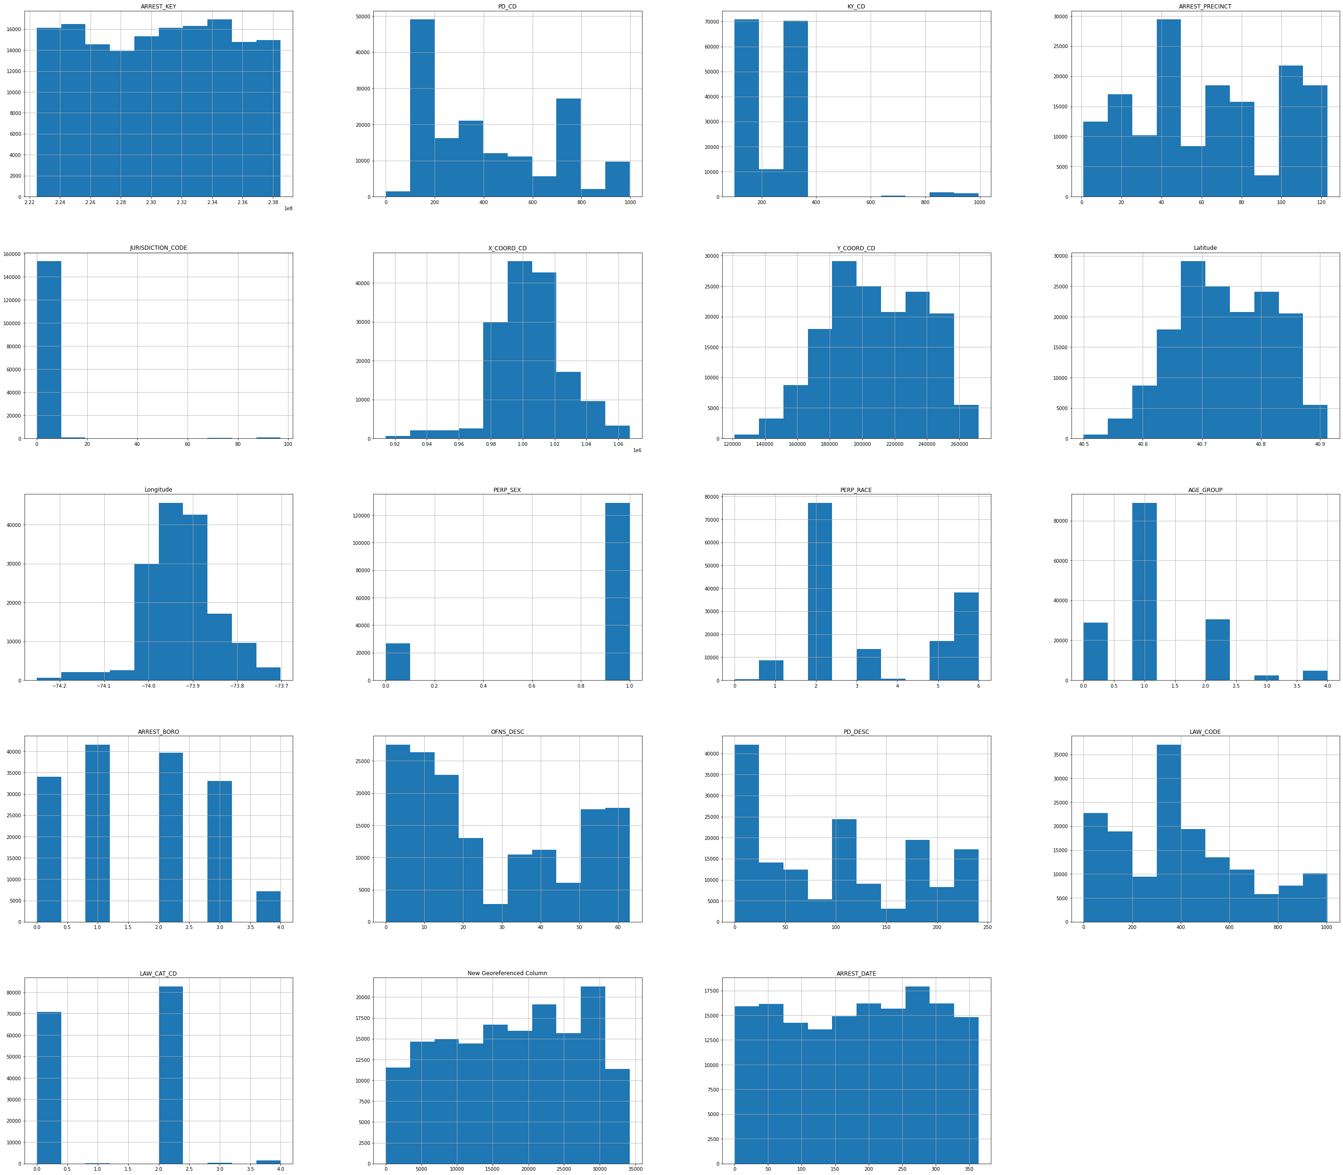
Exploratory Data Analysis – Numeric Variable – Univariate Analysis
Visualizing the distribution of numeric variables using histograms to gain an understanding of the distribution of each attribute in the dataset.

Slide 10
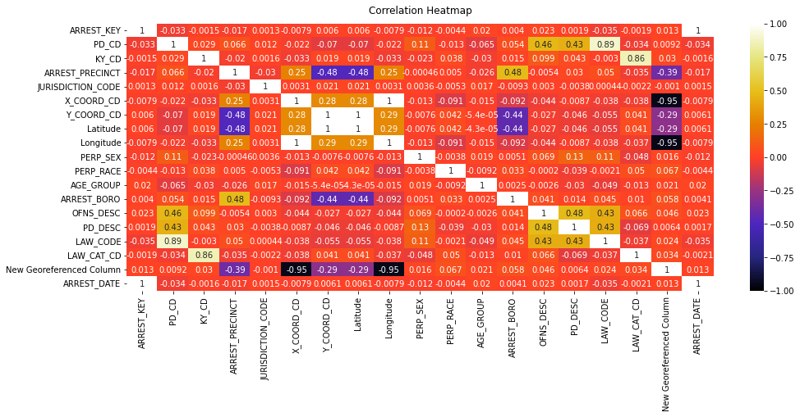
Exploratory Data Analysis – Numeric Variables – Correlation Analysis

Slide 11

Exploratory Analysis = Scatter Matrix plot after applying PCA

Slide 12
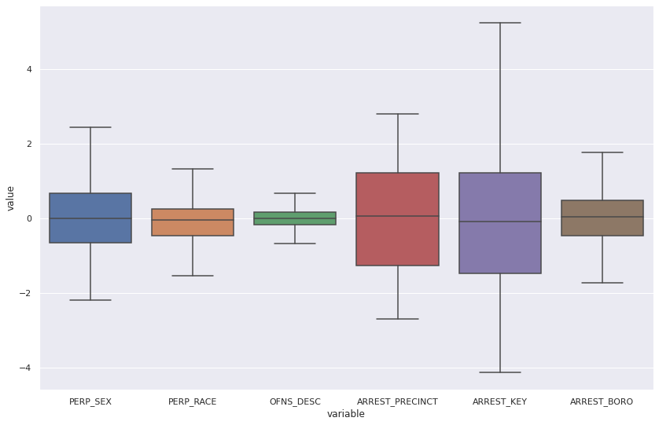
Exploratory Analysis – Numeric – Multivariate Analysis

Slide 13

Exploratory Analysis - Pie Chart

Slide 14
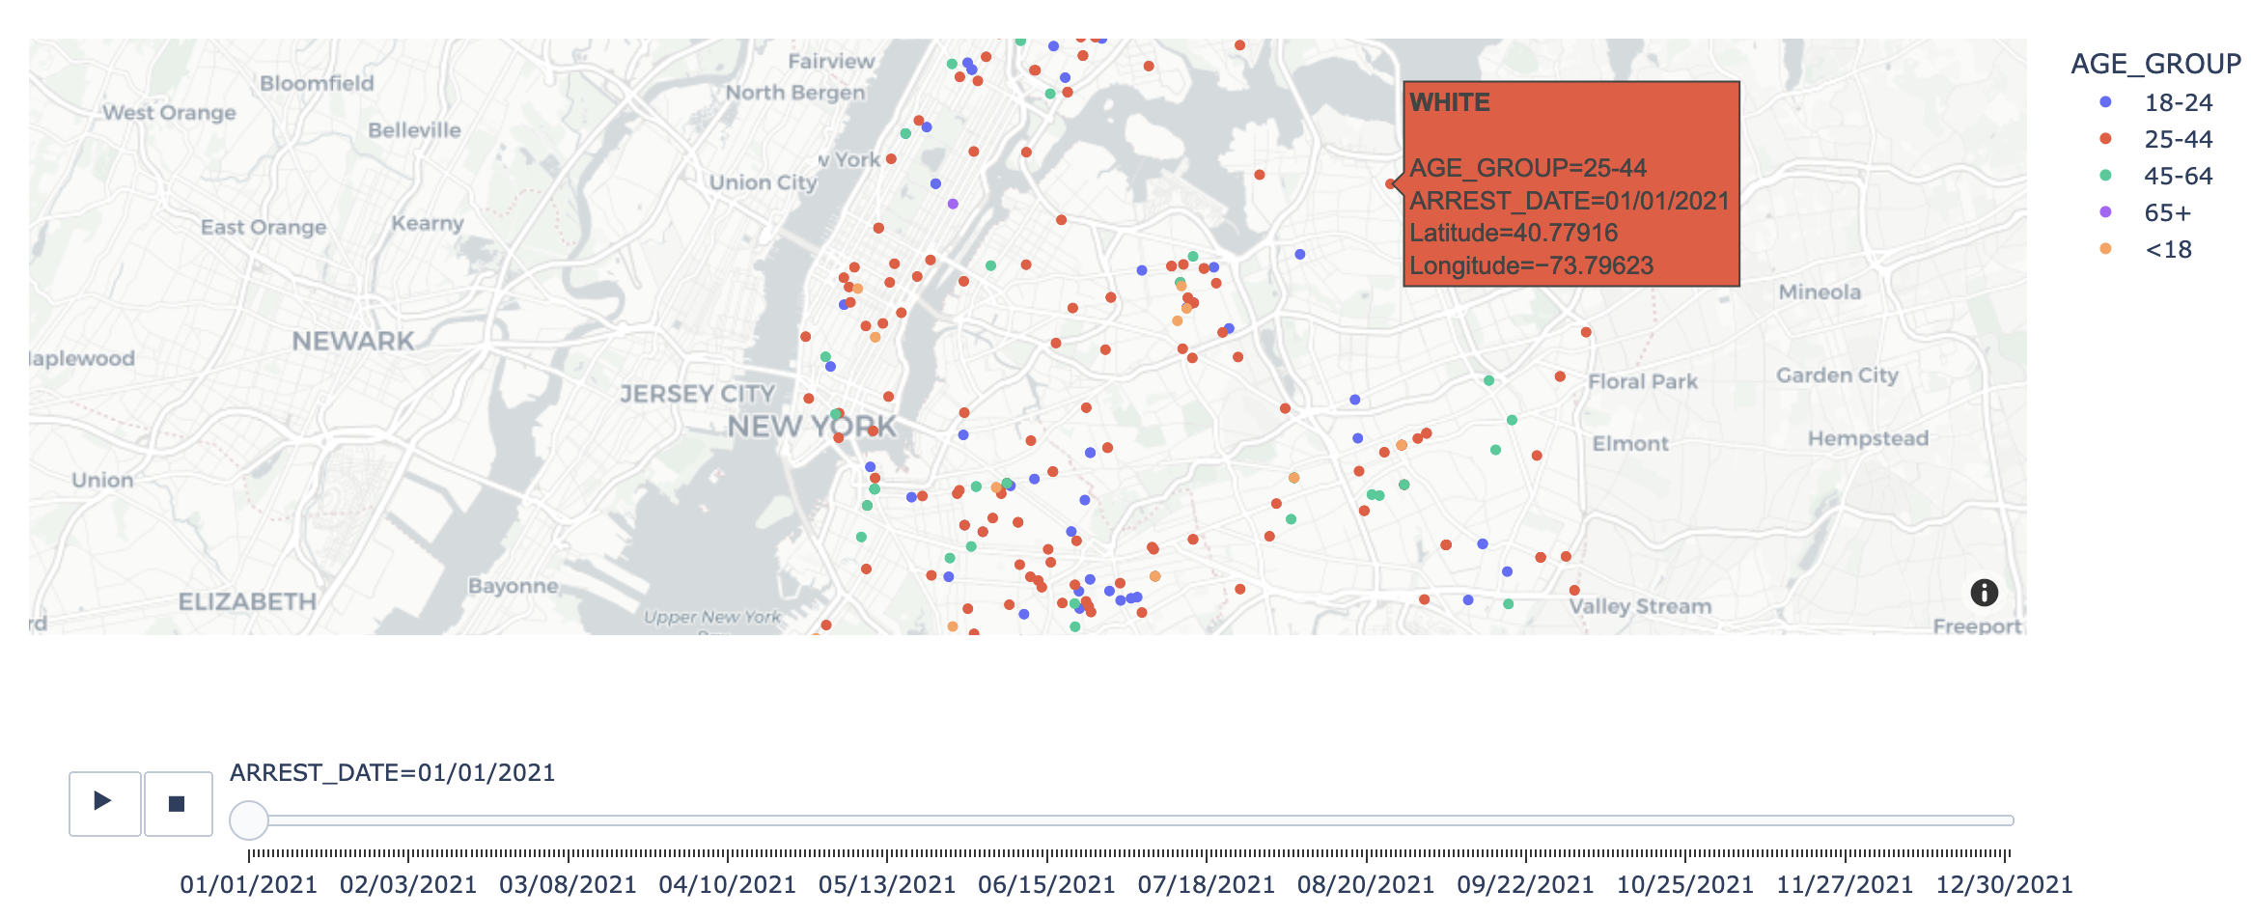
Exploratory Analysis - Scatter Map Box

Slide 15
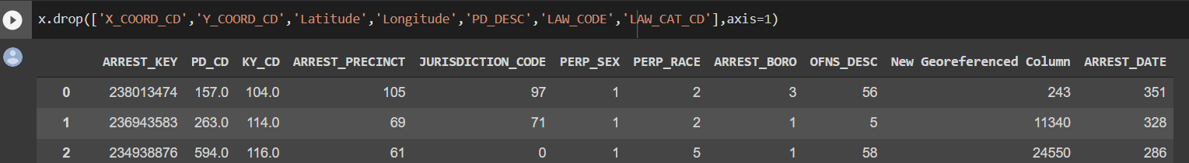
Dimension Reduction and Variable Selection
First, we have selected our target variable "AGE_GROUP" from the dataset.
After carefully observing the correlation relationship of each variable with the target variable in the correlation heat map, we have decided to drop 7 variables from the dataset.
These variables won't have an impact on the model performance or performance scores like accuracy, rmse etc., in the later part of the project.

Slide 16
Model Exploration and Model Selection Model Building
1. KNeighborsClassifier: Key Idea: a non-parametric model that uses similar records or K Nearest Neighbors to classify a new record from test data with a majority voting decision rule.
Implementation: KNeighborsClassifier was run over 80 iterations with an accuracy of 58%.
2. RandomForestClassifier: Key Idea: Random forest is a versatile, easy-to-use machine learning algorithm that, in most cases, gives excellent results even without hyper-parameter tuning.
Implementation: RandomForestClassifier was run over taking 180 estimators with an accuracy of 59%
3. MLPClassifier: Key Idea: Unlike other classification methods such as Support Vectors, MLPClassifier performs classification using an underlying Neural Network.
Implementation: The classification model was executed resulting in an accuracy of 57.96%.
4. LogisticRegression: Key Idea: Logistic Regression is a statistical approach and a Machine Learning algorithm based on the concept of probability that is used to solve classification problems.
Implementation: Model was evaluated over 15 hyperparameters and gave an accuracy of 57.45%
5. GaussianNB: Key Idea: It is a special type of NB algorithm. It's also assumed that all the features are following a gaussian distribution i.e., normal distribution. Implementation: Accuracy of 57.19%.

Slide 17
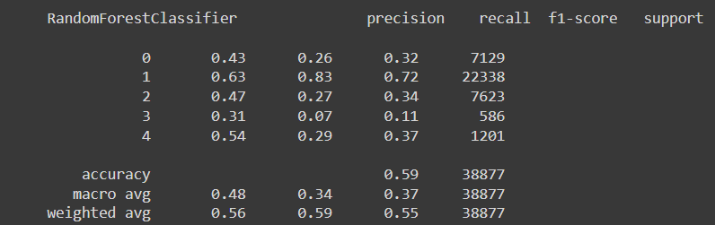
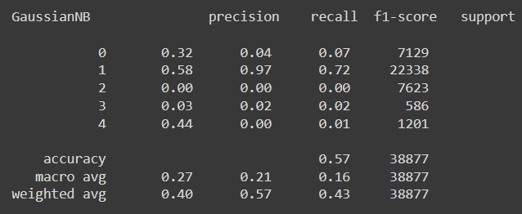
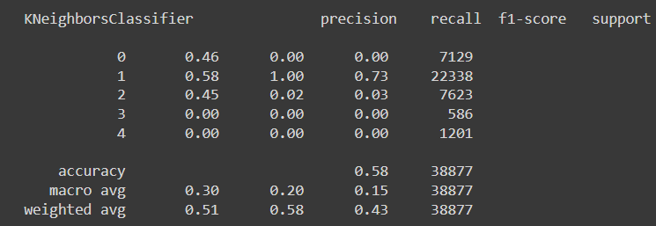
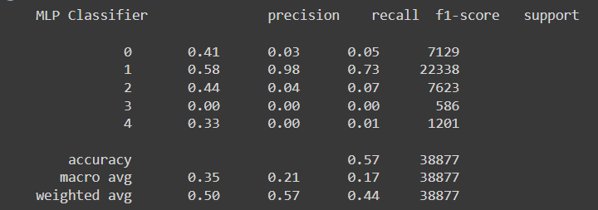
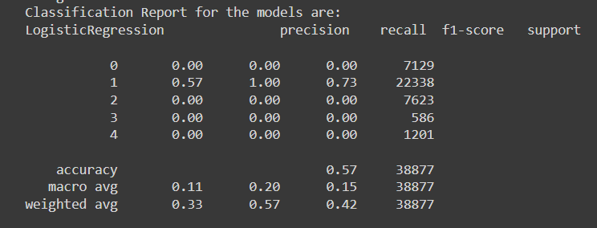
Performance Evaluation
KNN
Random Forest
Naïve Bayes
MLP
Logistic Regression

Slide 18
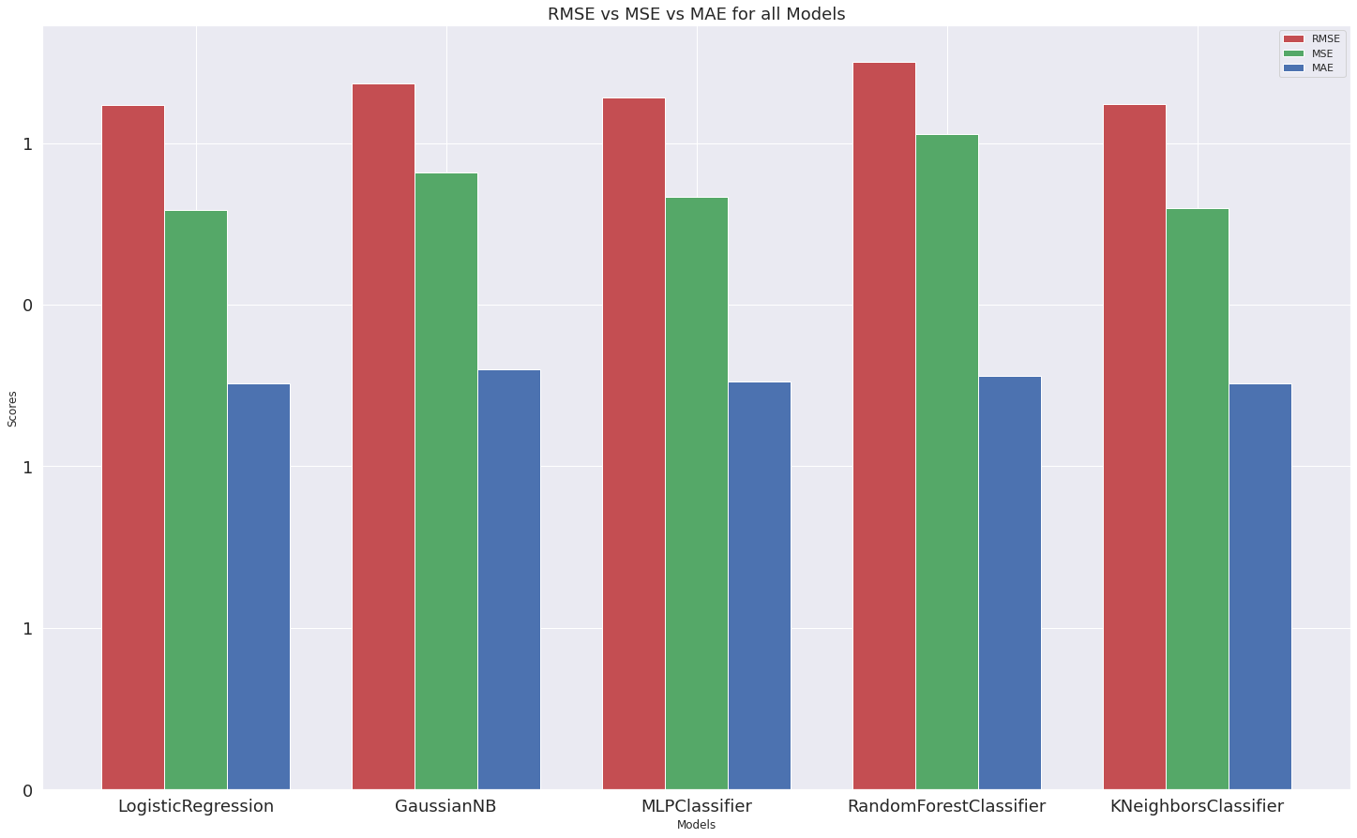
Performance Evaluation

Slide 19
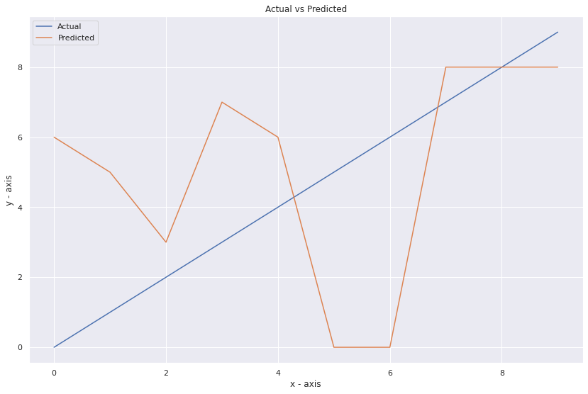
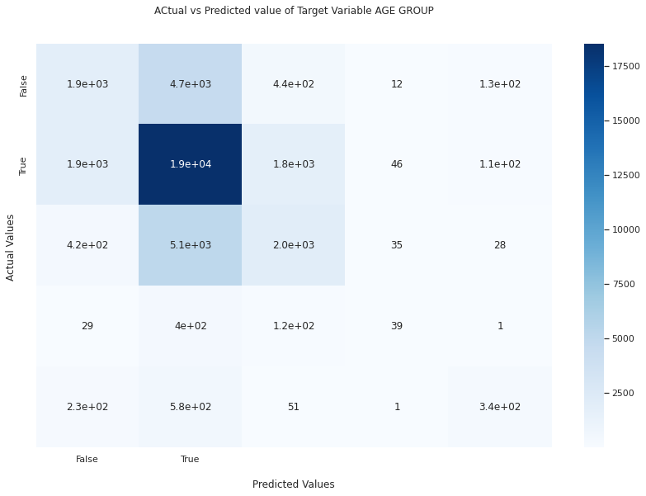
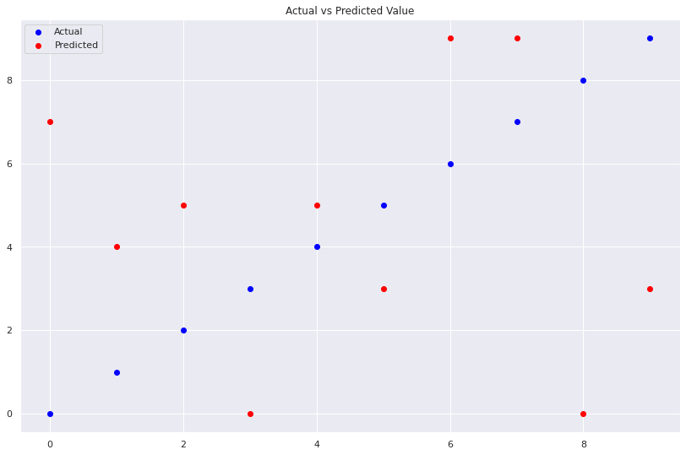
Project Results
Actual Vs Fitted Value (Line Chart)
Actual Vs Fitted Value (Confusion Matrix)
Actual Vs Fitted Value (Scatterplot)

Slide 20
Impact of the project outcomes
For the investigation process, law enforcement officials and investigators collect raw data from various sources such as telephone records, social networks, police records, and transaction records.
This is a time-consuming task, but new technologies and tools can assist law enforcement in efficiently identifying criminals. This project examined various data mining tools and techniques for identifying specific crime patterns in a specific location at a specific time.
According to the reports, crime data mining has the potential to improve national security as well as intelligence productivity and efficiency.
There are numerous future pieces of research on it that are still in the exploratory stage.

Slide 21
THANK YOU

